Slide 1


FINTECH

Slide 2

PROBLEM Statements-
How can we create a simple yet engaging digital platform that brings to life financial education at great scale in order to improve understanding of basic financial concepts and equip women and girls across India to make more informed financial choices regarding saving, investing, insuring and borrowing?

Slide 3

Problem--
Gender pay gap
Limited access to financial education
debt
Women are paid less than men and suffer gender based discrimination.
Women face a lack of educational resources especially in rural areas due to cultural barriers and domestic duties.
Women with low financial literacy are more likely to be debt constrained ,take a large amount of credit and student loans.
Emergency funds
Spending habits
Women with low financial literacy are more likely to not have an adequate emergency fund.
Women with low financial literacy are more likely to have poor spending habits.

Slide 4
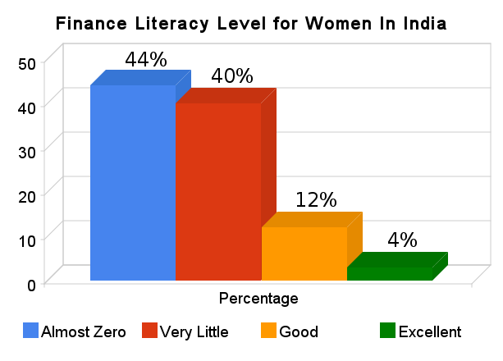

Slide 5
Solution--
Increasing Accessibility
Target audience
Women
Our product makes complex financial concepts easy to understand.
Personalized Guidance
Gender EQUALITY
Chatbot offering assistance on savings, investment, government schemes and loans
Can aid in closing the gender gap

Slide 6

Solution overview 1. earn 2.Spend 3. save 4.Invest

Slide 7
TYPES OF INCOMES--
3. INTEREST INCOME
4. DIVIDEND INCOME
1.EARNED INCOME
2. PROFIT INCOME
6. CAPITAL
GAINS
8. BUSINESS
5.RENTAL INCOME
7.ROYALTY INCOME

Slide 8
Types of spend--
Cash
Debit card
Credit card
Visa
No chances of debt
Not dependent on technology
Not Fraud protected
Loan on Cards but chances of Debt accumulation
Affordable EMI facilities
Fraud protection
No interest charges
No Bank account
No interest
Rewards such as points, discounts, cash back.
Limited funds

Slide 9
Savings--
Why do you want to save?
Save a part of your earning--
Open a Bank account
Know your needs
Wants
Debts
Use a part of your salary​ for
Expenditure and save the remaining account for future.
Savings Account
Fixed Deposit​

Slide 10
Opening an account--
1.Account type---
2.FILL THE FORM--
Select the account type–
Fixed Deposit
Saving Account
You can fill the form online or visit the nearest branches—
Name, address , phone no. , nominee name , Aadhar or voter id
3.Initial Deposit--
4.ONLINE MOBILE APPS--
You must deposit an initial amount while opening an account
500-1000 Rs for public sector banks
5000-10000 Rs for private sector banks
You can link your account to mobile using net banking to track up your account.

Slide 11

Interest Offered by banks-
BANK INTEREST RATE MINIMUM BALANCE
SBI :- 2.70% - 3.0 % p.a NIL
HDFC:- 3.0% p.a (<50 lakh) 10,000 (urban)
3.5% p.a (>50 lakh) 2,500 (rural)
ICICI:- 3.0% p.a (<50 lakh) 10,000
3.5% p.a ( >50 lakh)

Slide 12

INVestment --
Stock market
--Self directed
--broker
--robo adviser
Real Estate
Purchase , management, and sale of real estate for profit.
Invest in business or gold
Start business by yourself , or buy share of stocks in
company

Slide 13
Key Features of our website Market Data:
Real-time updates on stocks, commodities, and indices. Investment Advice Professional insights and strategies for beginners and experienced investors.
Personal Finance Tools: Budget planners, retirement calculators, and tax advice .
Educational Resources: Articles, tutorials, and videos on financial literacy.
Mission To empower individuals and businesses with the knowledge and tools they need to make informed financial decisions, grow their wealth, and secure their financial future.

Slide 14

Why to focus on women?
Women needs are Higher because--
They typically have fewer financial resources (low labor market protection​​, low earning, discontinuous earning for caring activities).
L
Live longer on average than men
Therefore need to manage resources well and for longer period of time to improve access to financial opportunity and to avoid poverty in older times.

Slide 15
GOVERNMENT SCHEMES--
1.PRADHAN MANTRI MUDRA YOJANA--
Set up by govt providing loans up to 10 lakh to the non corporate, non farming small &micro enterprises.
2.Atal pension yojana
it is available to any citizen of India within age 18-40 yrs. The subscriber would receive minimum pension of Rs 1000 per month
3.Pradhan mantri Suraksha bima yojana
available to people between 18-70 years of age . It has an annual premium of Rs 20.

Slide 16

Summary
THROUGH THIS PROJECT WE HAVE TRIED TO EXPLAIN THE SIMPLE ABD EASY APPROACH TO HELP WOMENS TO LEARN TO SAVE AND INVEST MONEY. WE HAVE FURTHER PLANNED TO IMPLEMENT THIS IDEA ON A MOBILE APP WHERE THE APP CAN BE CUSTOMIZED ACCORDIN TO THE AGE GROUP OF WOMEN AND HER PROFFESION AND WILL PROVIDE RECOMMENDATION THROUGH CHATBOTS.

Slide 17

Thank you
Sanat Kumar Verma
Shruti Shukla
Divya verma

